Slide 1
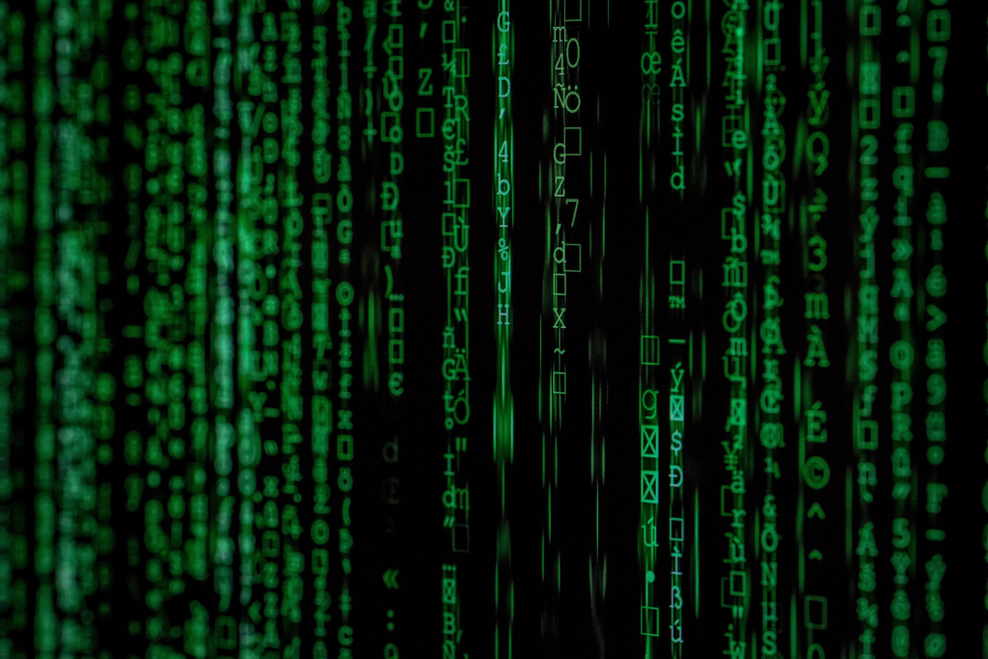

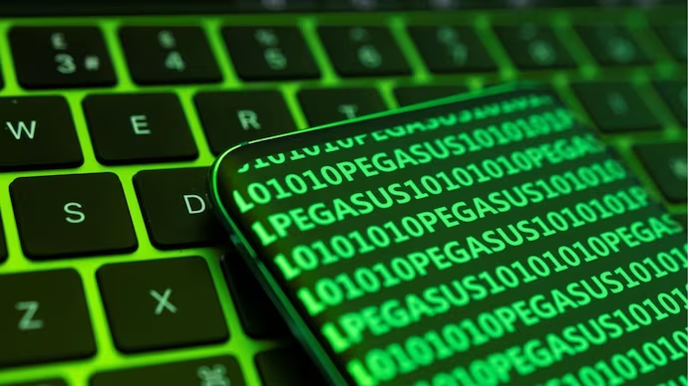
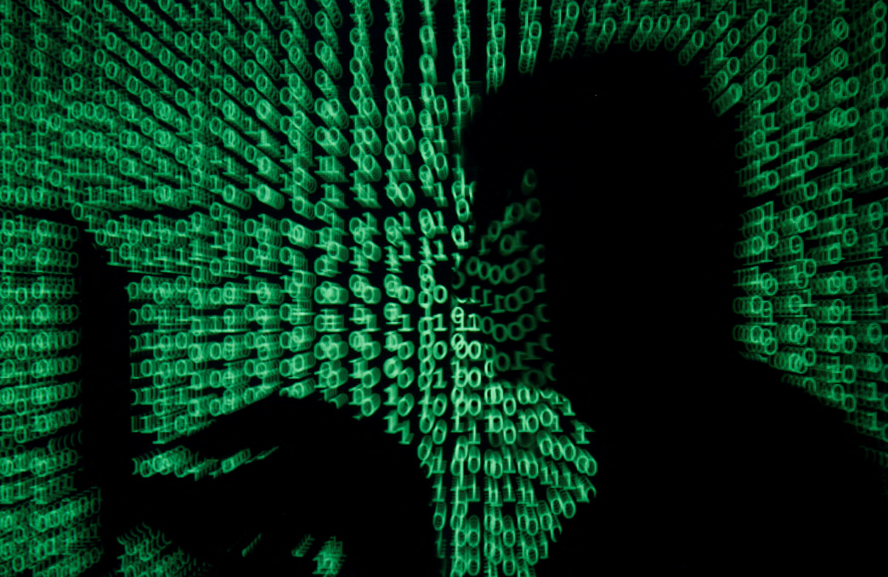
presents
Team details:
Ashish Ruke
Anushka Pote
Harshvardhan Kulkarni
datathon
2.0
Where Data Science transforms Ideas into impact

Slide 2
Personalised Learning Application

Slide 3
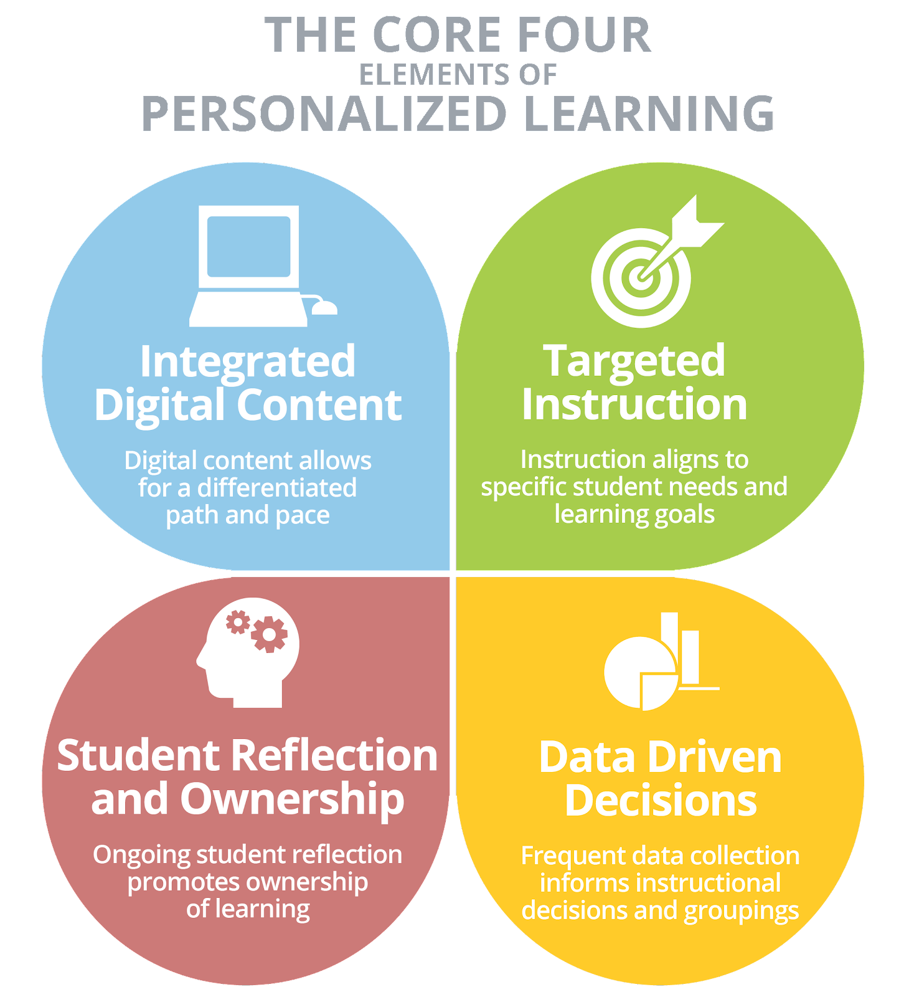
Introduction
Personalised Learning Application (PLA) is a powerful tool for individualized education.
It uses technology to tailor learning experiences to each student's unique needs.
It promotes self-paced learning, engagement, and academic success.
Notes:
Image source: https://collaborative-learning.theteamie.com/blog/9-ways-to-promote-personalised-learning-and-differentiated-instruction-through-your-lms

Slide 4
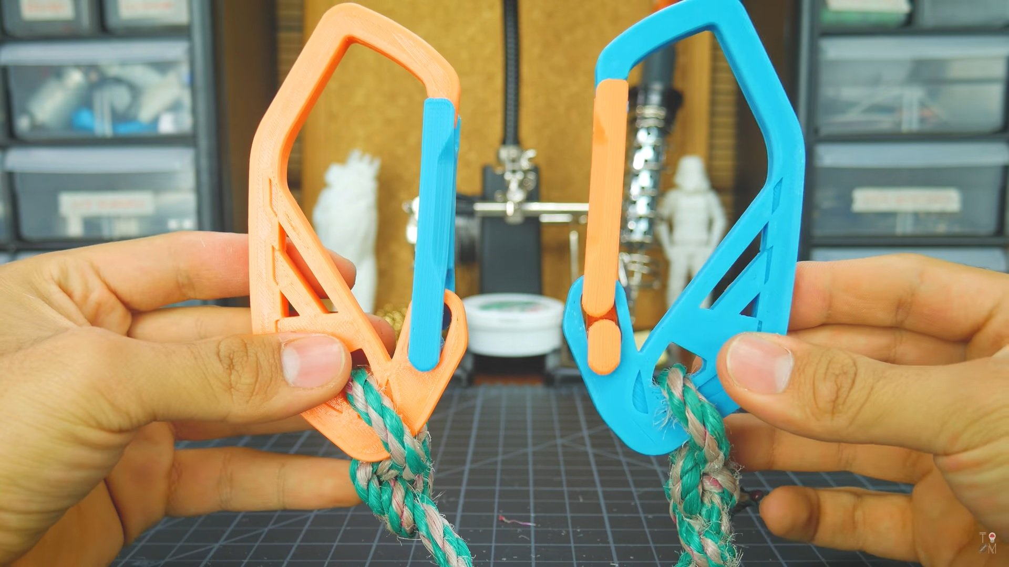
Benefits
It allows students to learn at their own pace, ensuring mastery of concepts.
It provides personalized feedback and recommendations for improvement.
It motivates students by offering interactive and engaging learning experiences.
Notes:
Image source: https://all3dp.com/2/pla-vs-pla-3d-printer-filament-compared/

Slide 5
Features
Adaptive assessments in PLA help identify students' strengths and weaknesses.
PLA offers a variety of multimedia resources to cater to different learning styles.
PLA tracks students' progress and provides real-time data for teachers and parents.
Notes:
Image source: http://www.northwestern.edu/searle/assessment-of-student-learning/assessment-process/index.html

Slide 6
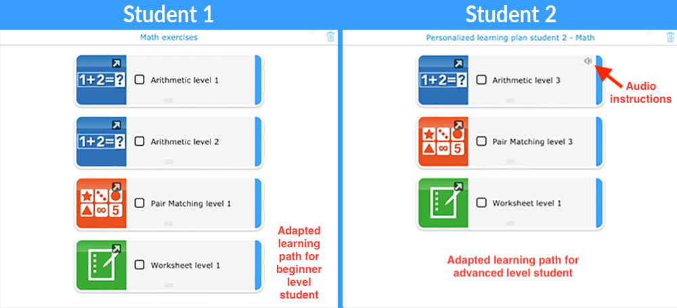
Customization in PLA
It allows students to choose their own learning paths and goals.
It offers personalized content based on students' interests and preferences.
It adjusts difficulty levels based on students' performance and prior knowledge.
Notes:
Image source: https://www.pinterest.com/pin/395542779771221882/

Slide 7
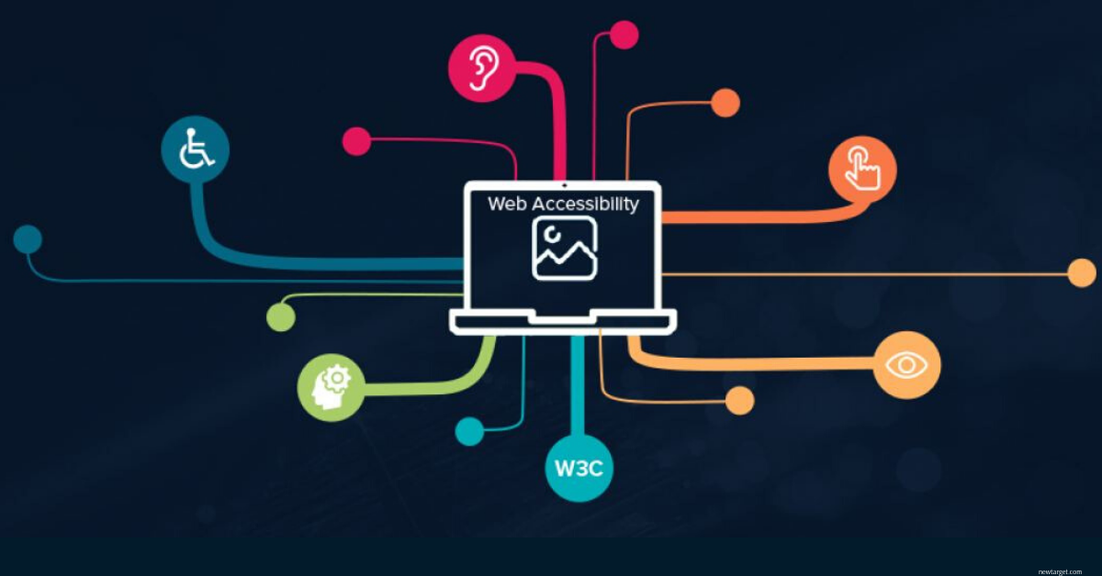
Accessibility
It can be accessed anytime and anywhere through mobile devices and computers.
It provides opportunities for students with different abilities.
It optimises difficulty levels for each student in various courses.
Notes:
Image source: https://blog.onebcg.com/2019/10/making-web-accessible.html

Slide 8
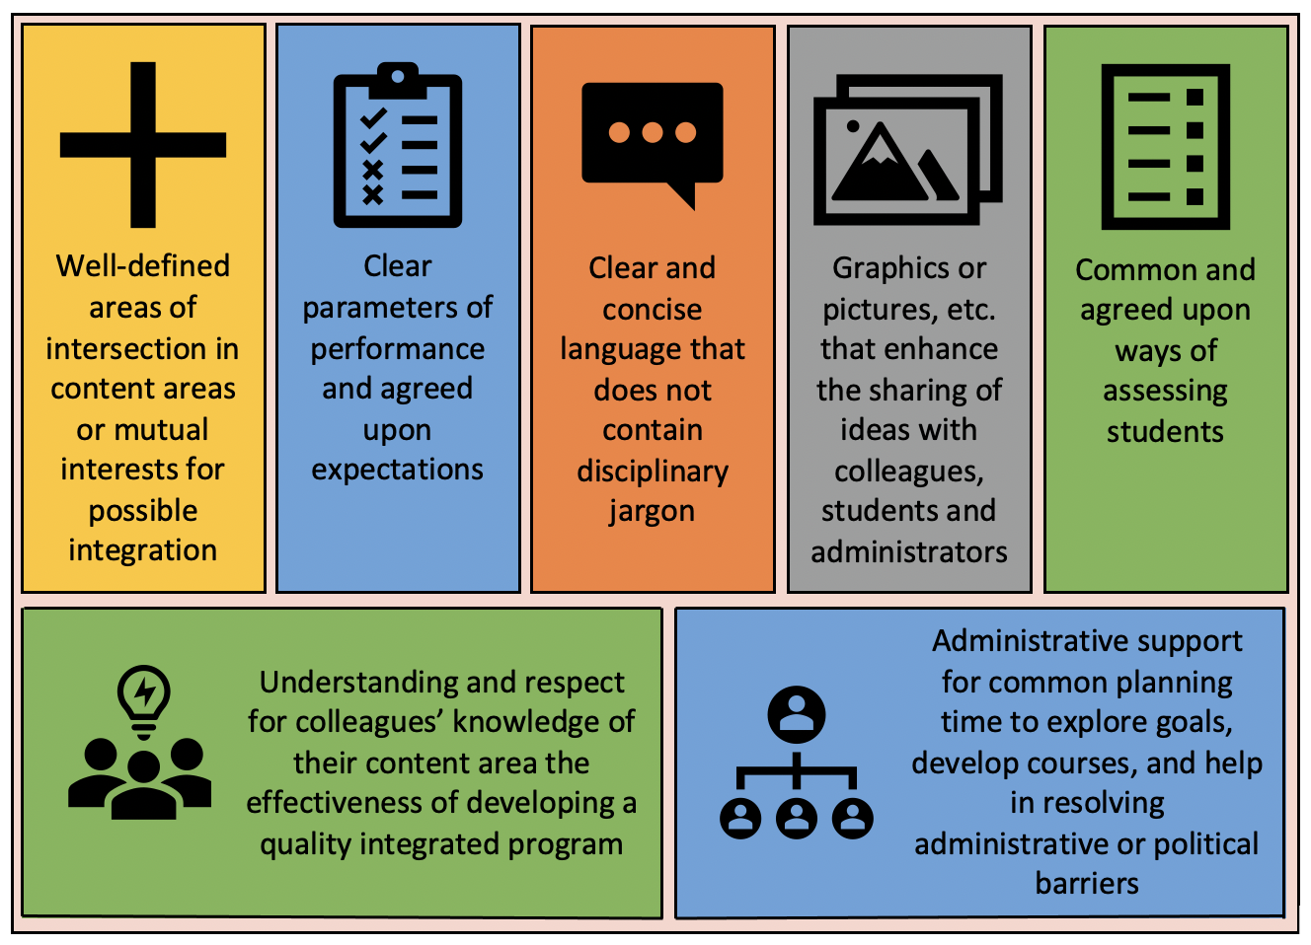
Implementation of PLA
Technologies used:
Flask:
Backend Framework: Utilized Flask, a lightweight and flexible Python web framework.
Routing and API Handling: Employed Flask to define routes and handle API requests for user interactions.
HTML and CSS:
User Interface (UI) Design: HTML used to structure the content, while CSS employed for styling and layout.
Responsive Design: Ensured a responsive design for seamless user experience across various devices.
Notes:
Image source: https://oer.pressbooks.pub/curriculumessentials/chapter/curriculum-integration/

Slide 9
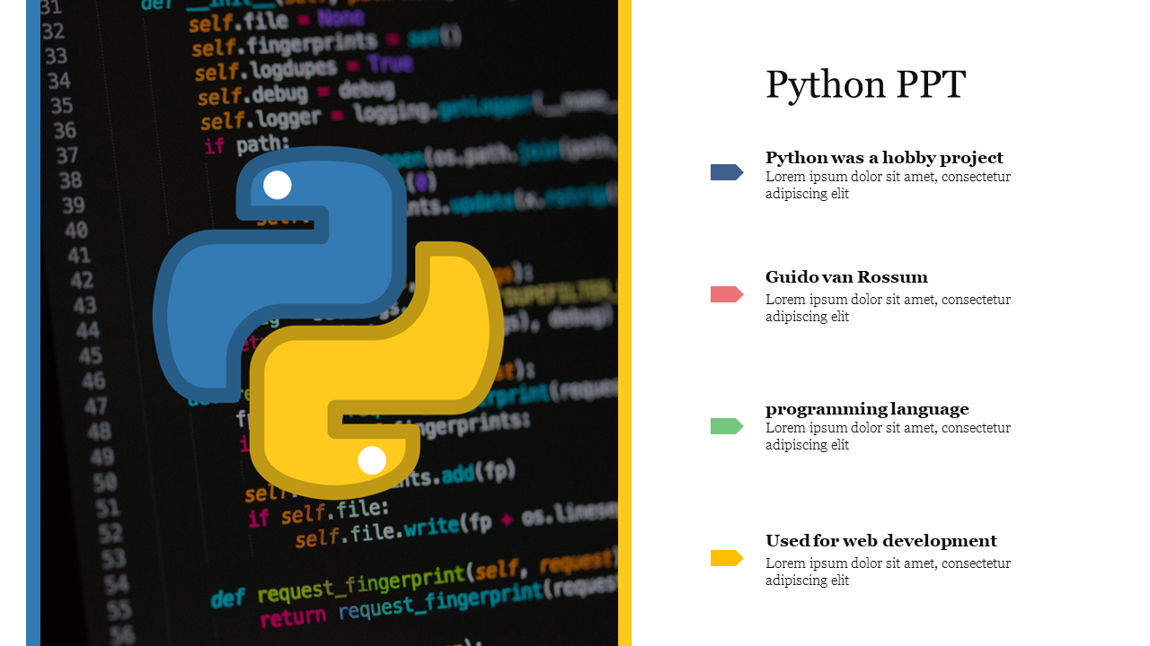
Source code and Demonstration
You can find the all the relevant files as well as a video demonstration right here.
Notes:
Image source: https://oer.pressbooks.pub/curriculumessentials/chapter/curriculum-integration/

Slide 10
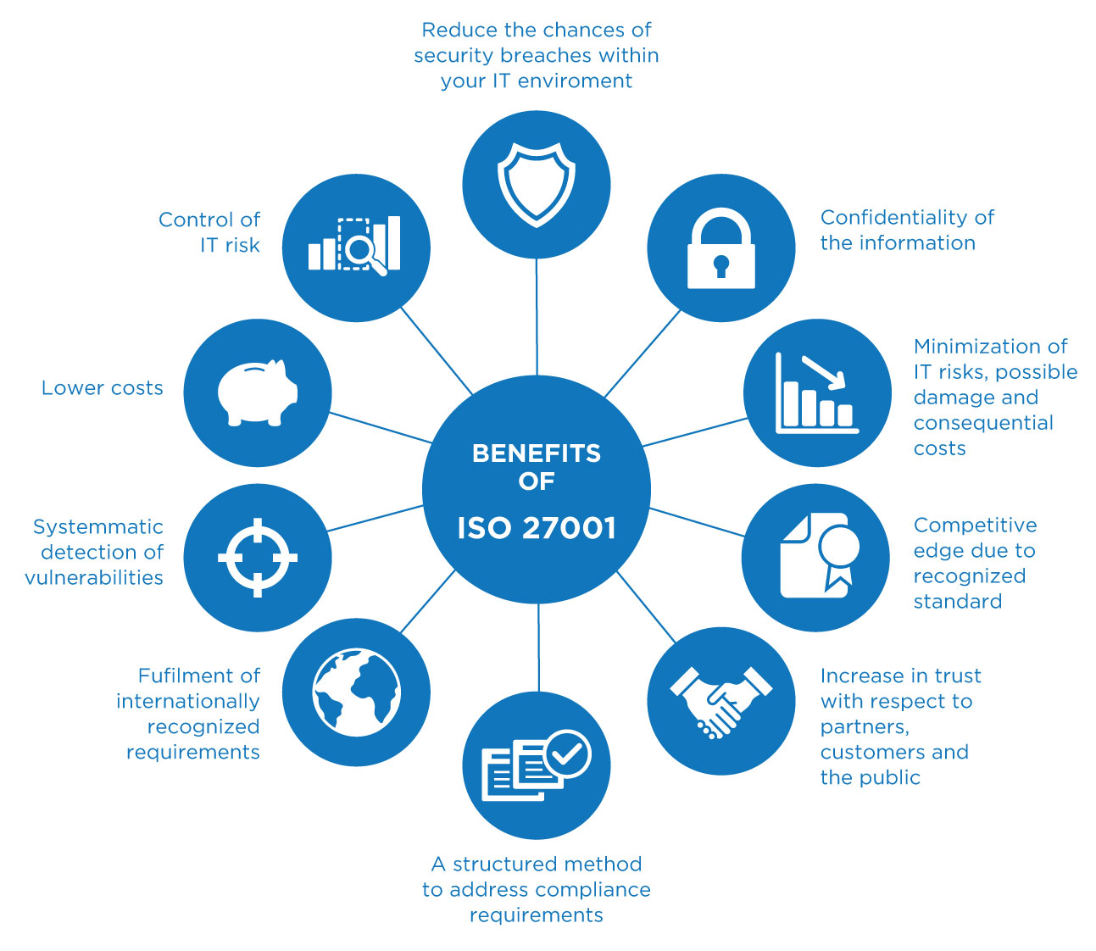
Challenges of PLA
Initial setup and training may be required for effective implementation.
Privacy and security concerns need to be addressed when using PLA.
Ensuring equitable access to technology and internet connectivity can be a challenge.
Notes:
Image source: https://quint-next.blogspot.com/2021/06/iso-27001-implementation-roadmap.html

Slide 11
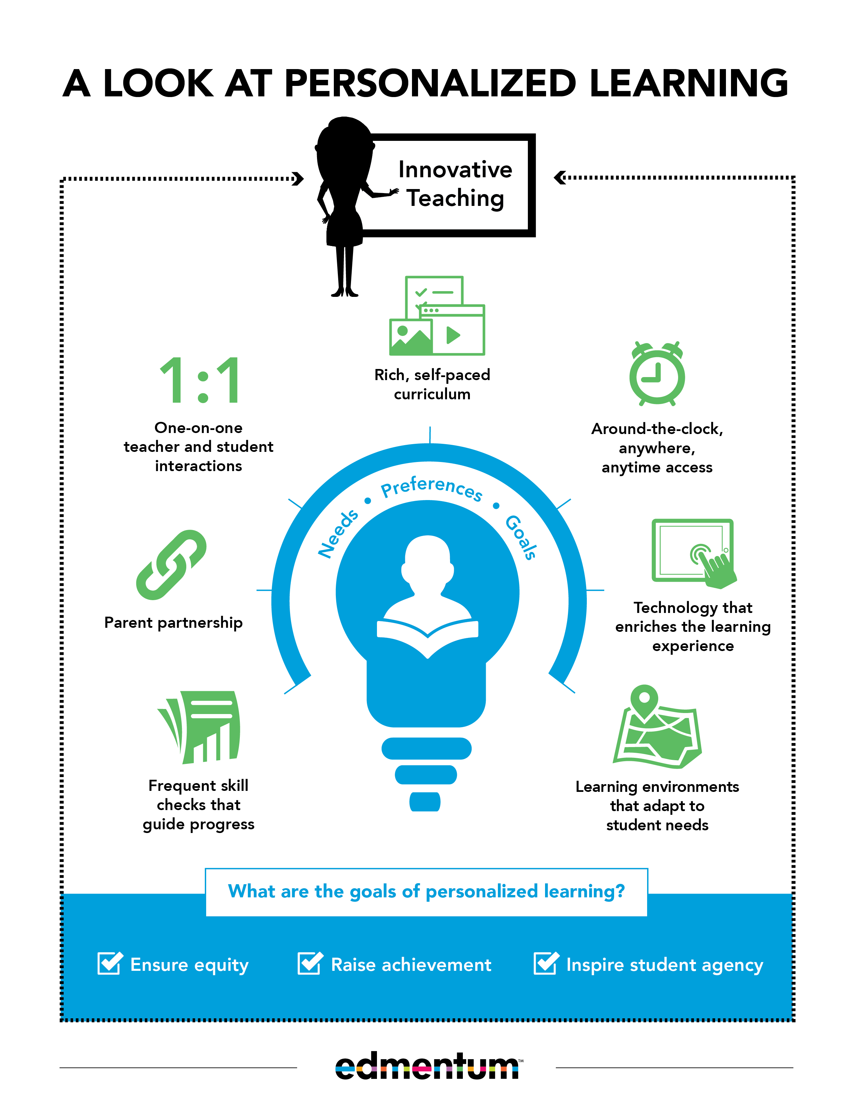
Conclusion
Personalised Learning Applications revolutionize education by individualizing learning experiences.
PLA enhances student engagement, motivation, and academic achievement.
With proper implementation and support, PLA can transform education for the better.
Notes:
Image source: http://elearninginfographics.com/defining-personalized-learning-infographic/

Slide 12
Thank you

